Slide 1
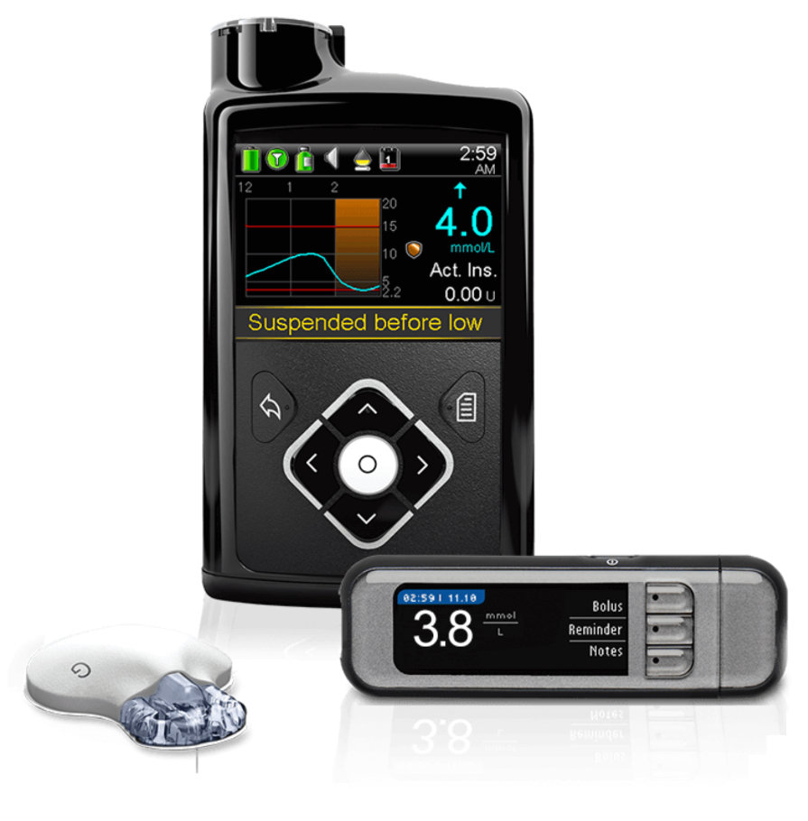
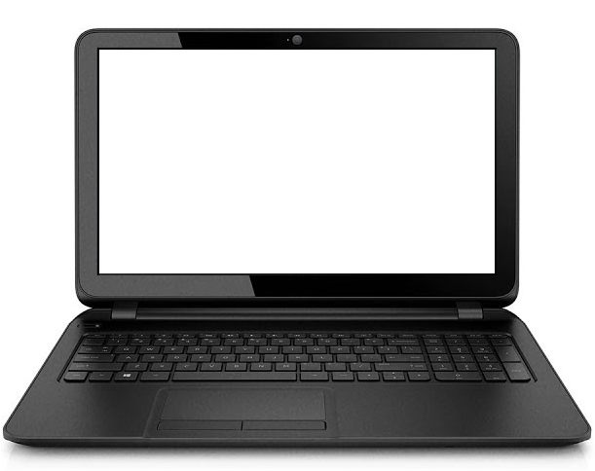
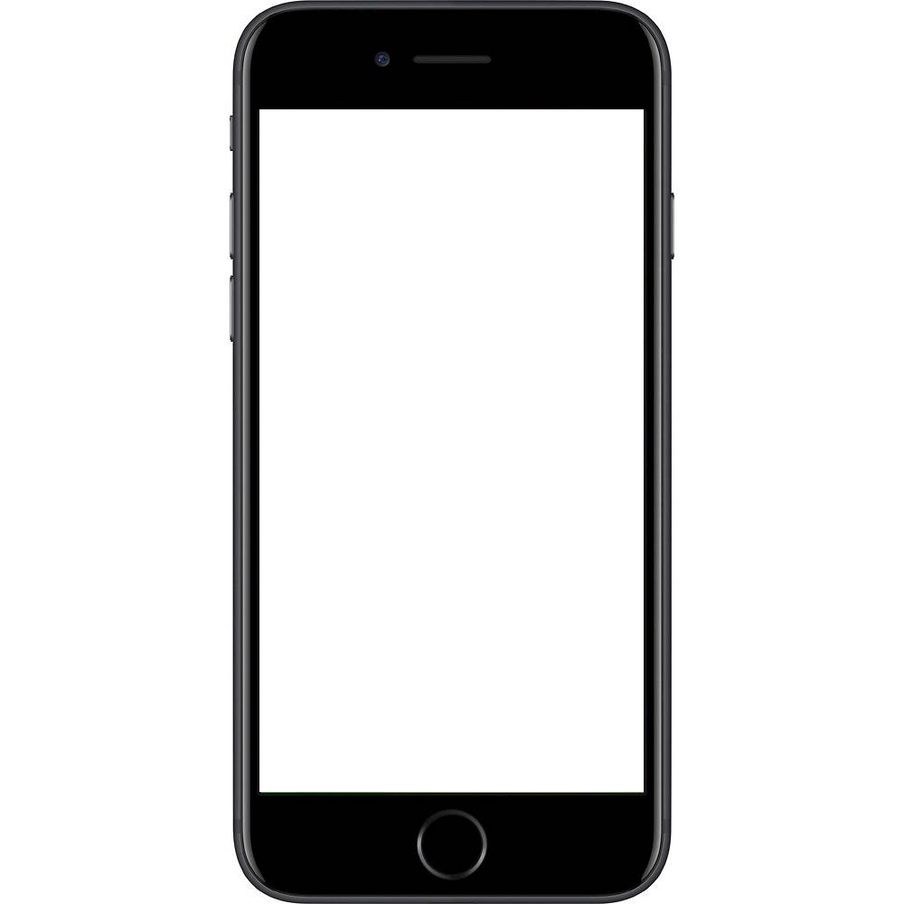

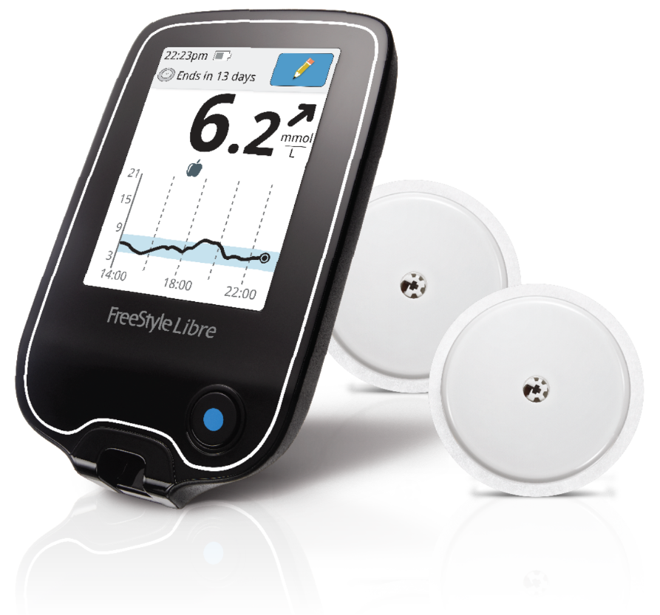


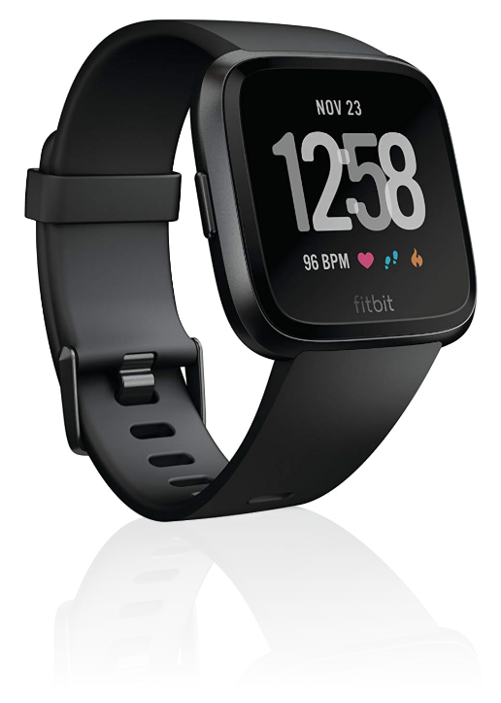
Device API
Nightscout REST API
Kanta PHR API
Nightscout
Nightscout web view
Night-scout App
Nightscout Connect
Kanta PHR
Tidepool
Tidepool Uploader
Sensotrend
Sensotrend Uploader
Sensotrend Uploader

